Slide 1
Flip-Chip Packaging of Fluxonium Qubits - marts Somoroff2023
Amalie Paulsen

Slide 2
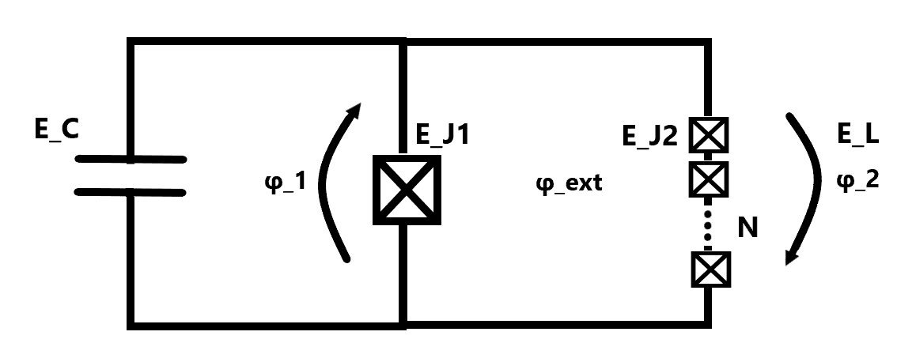
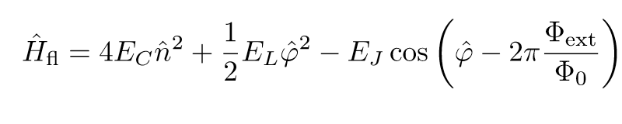
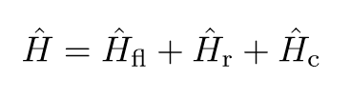
Fluxonium circuit
Notes:
When you couple the fluxonium into a circuit you also take into account the coupling with the resonator and the resonator itself.

Slide 3
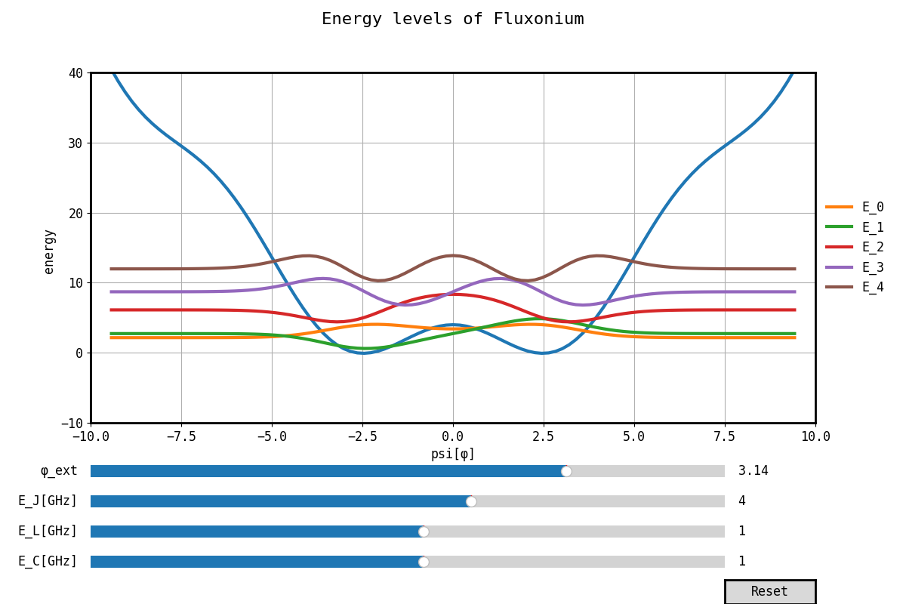
Fluxonium specs – optimal
Type of qubit: flux qubit tuned by the flux through the Josephson junctions = E_J and the capacitance energy = E_C.
Some benefits:
Large anharmonicity
Long decoherence times
Optimal parameters E_J/h = 4GHz, E_L/h = 1GHz, E_C/h = 1GHz.
Notes:
It is a flux qubit which mean that the parameters (like the josephson energy is changed by a change in the flux lines).
There are 2 main big groups which makes fluxonium. (One at berkly university By Nguyen) and the Manucharyan group which is the founding fathers of fluxonium). There are also other groups like marta (David phD supervisor – but I don’t think that is the main-occupation in the group).
There was an article called Blueprint for a High-Performance Fluxonium Quantum Processor made last yearh which by the revival group of Nguyen.
E_l small => L large => each jj large =difficult with not a lot of space.

Slide 4
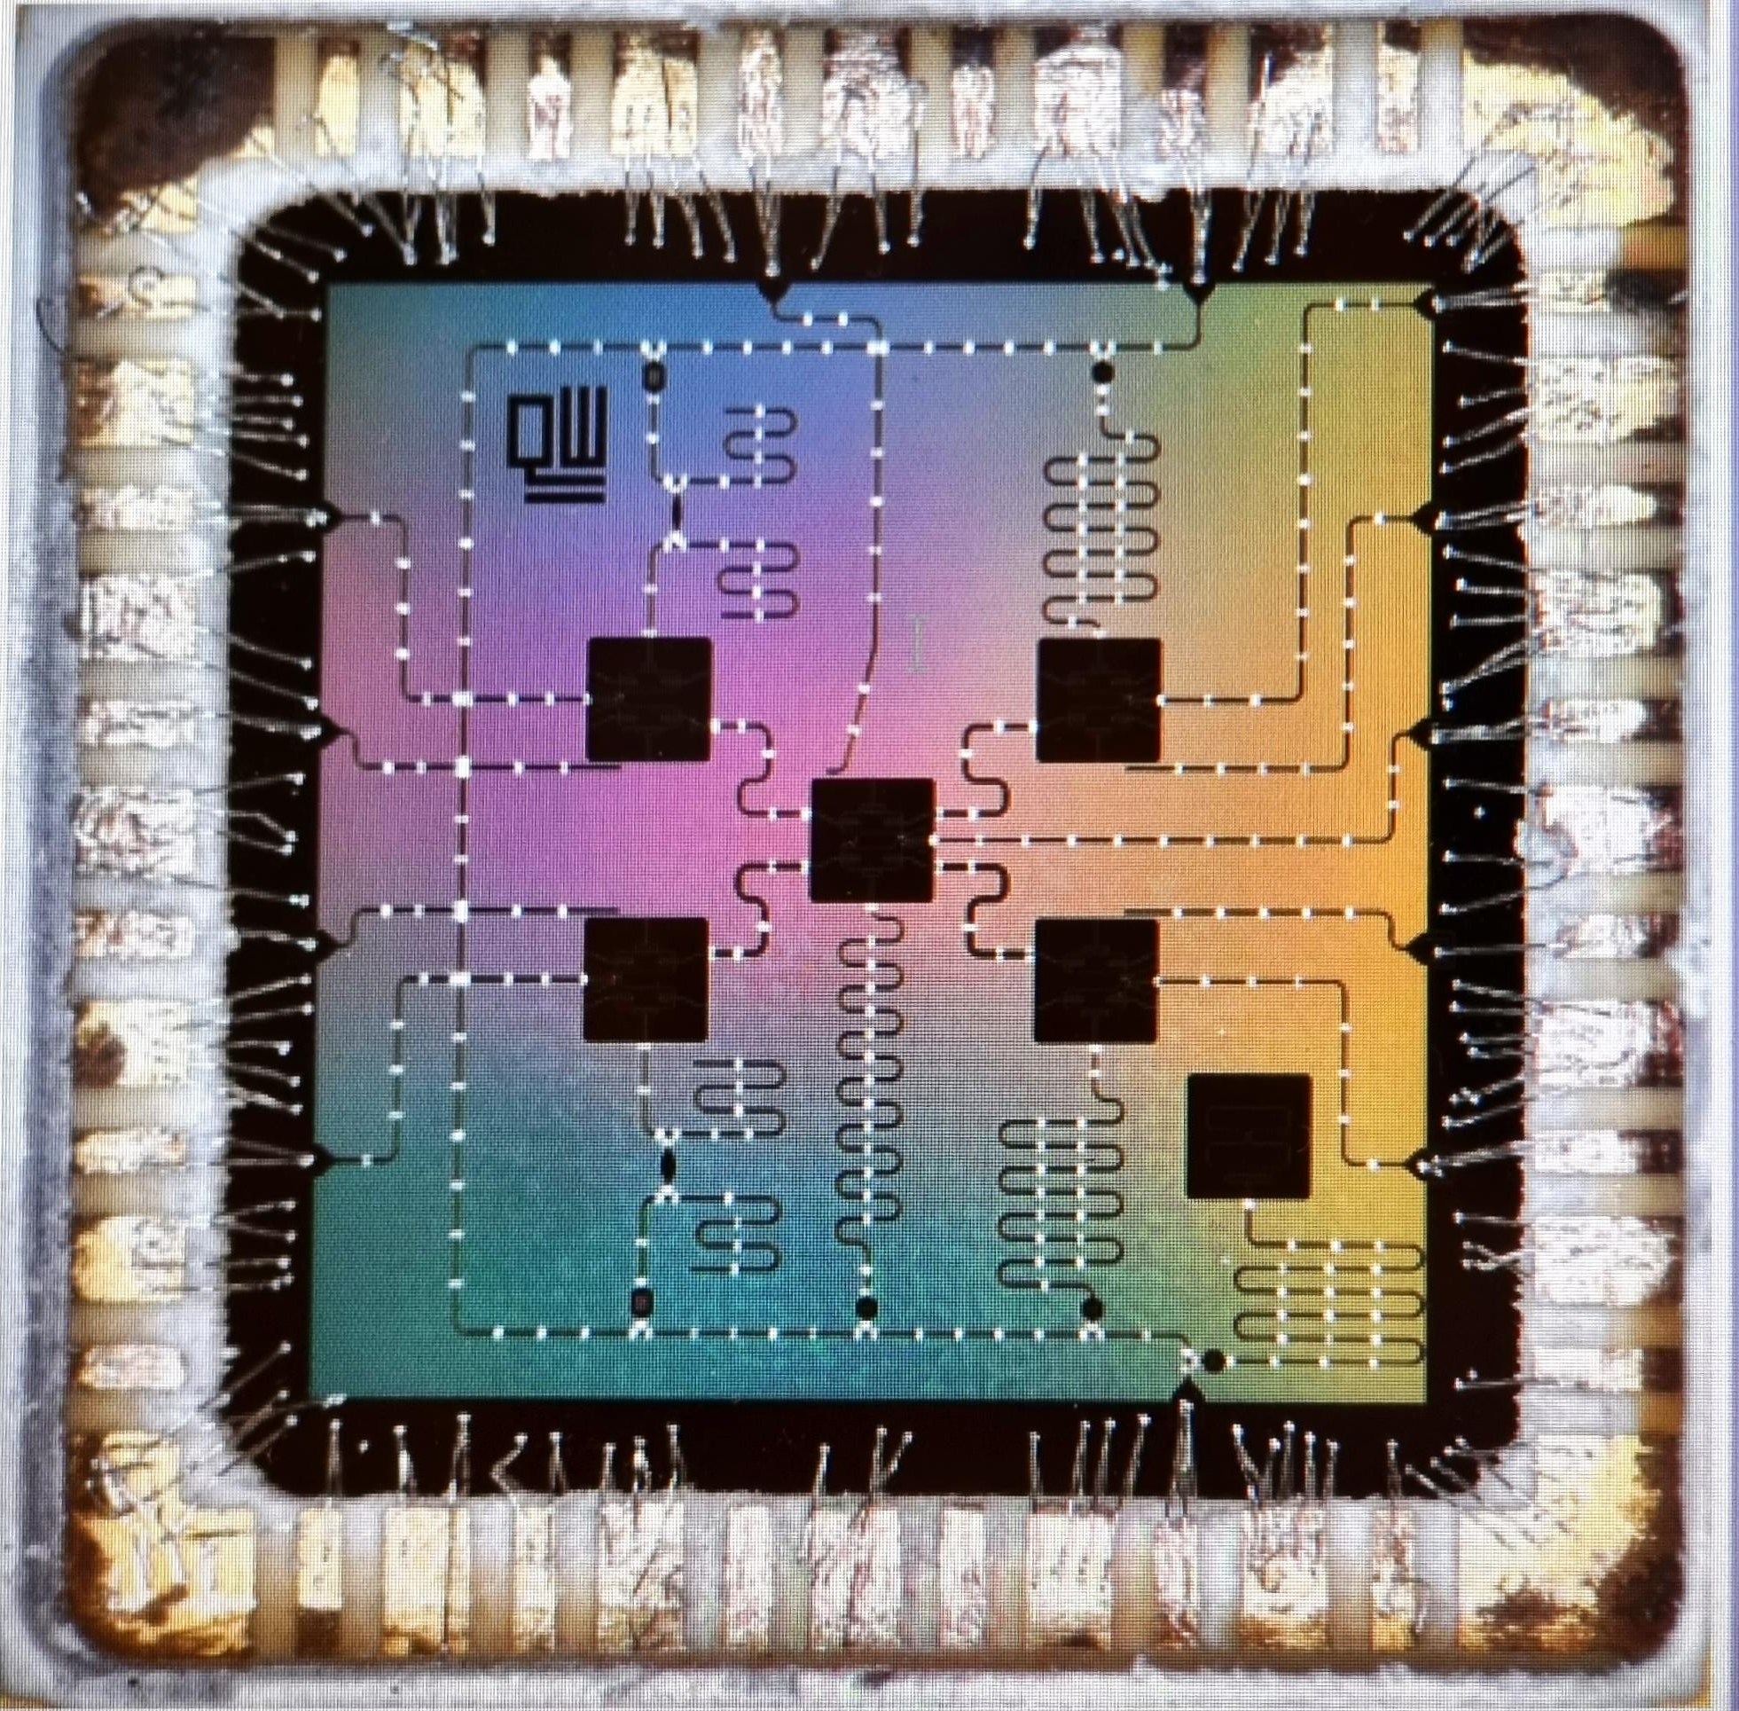
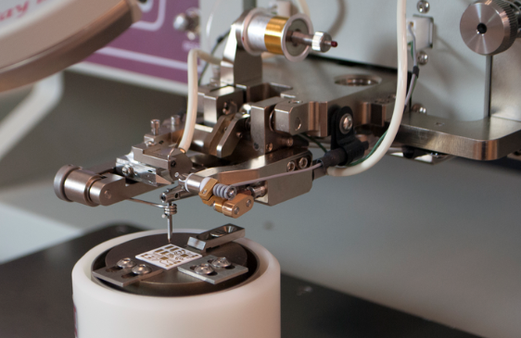
Wire bonding to a chip carrier
Notes:
You use wire bonding to bond your chip to a board (pcb) which can be connected to dc and rf generators.
Usually you bond the chip to the ground and to the fit-line.
Like a sawing machine but instead of thread it has a metal like aluminium. Instead of getting a “undertråd” it apply a voltage to “melt” the threat onto the chip/chip-carrier.

Slide 5
Scaling
Challenges
Cross talk between qubits.
Noise occur in all steps (manipulation, readout etc.).
At a certain point when you scale, in a normal wire-bonded chip, you would end up having a lot of routes which crosses.
Minimize the crosses by using a flip chip approach and bump bonding
Notes:
Minimize the crosses by using a flip chip approach

Slide 6
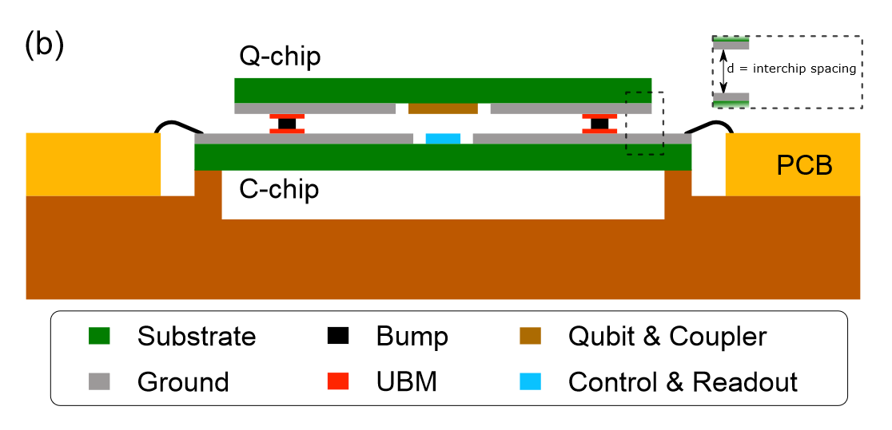
Flip chip approach
2 chips (Q-chip and the C-chip)
The Q chip is bump bonded to the QPU(flip chip)(so it faces the carrier).
Seperated by vacuum.
Drive lines and readout resonators are capacitively coupled.
Notes:
- Carrier chip hosts the input/output wiring, i.e., control lines (XY and Z), readout resonators, and readout feedlines. (responsible for qubit control and readout)
- The Q chip contains only the qubits an

Slide 7
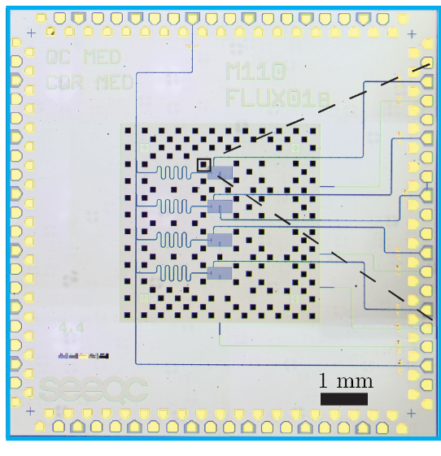
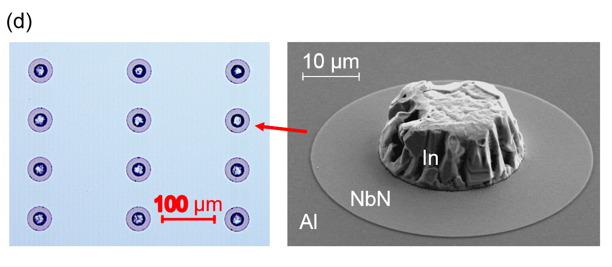
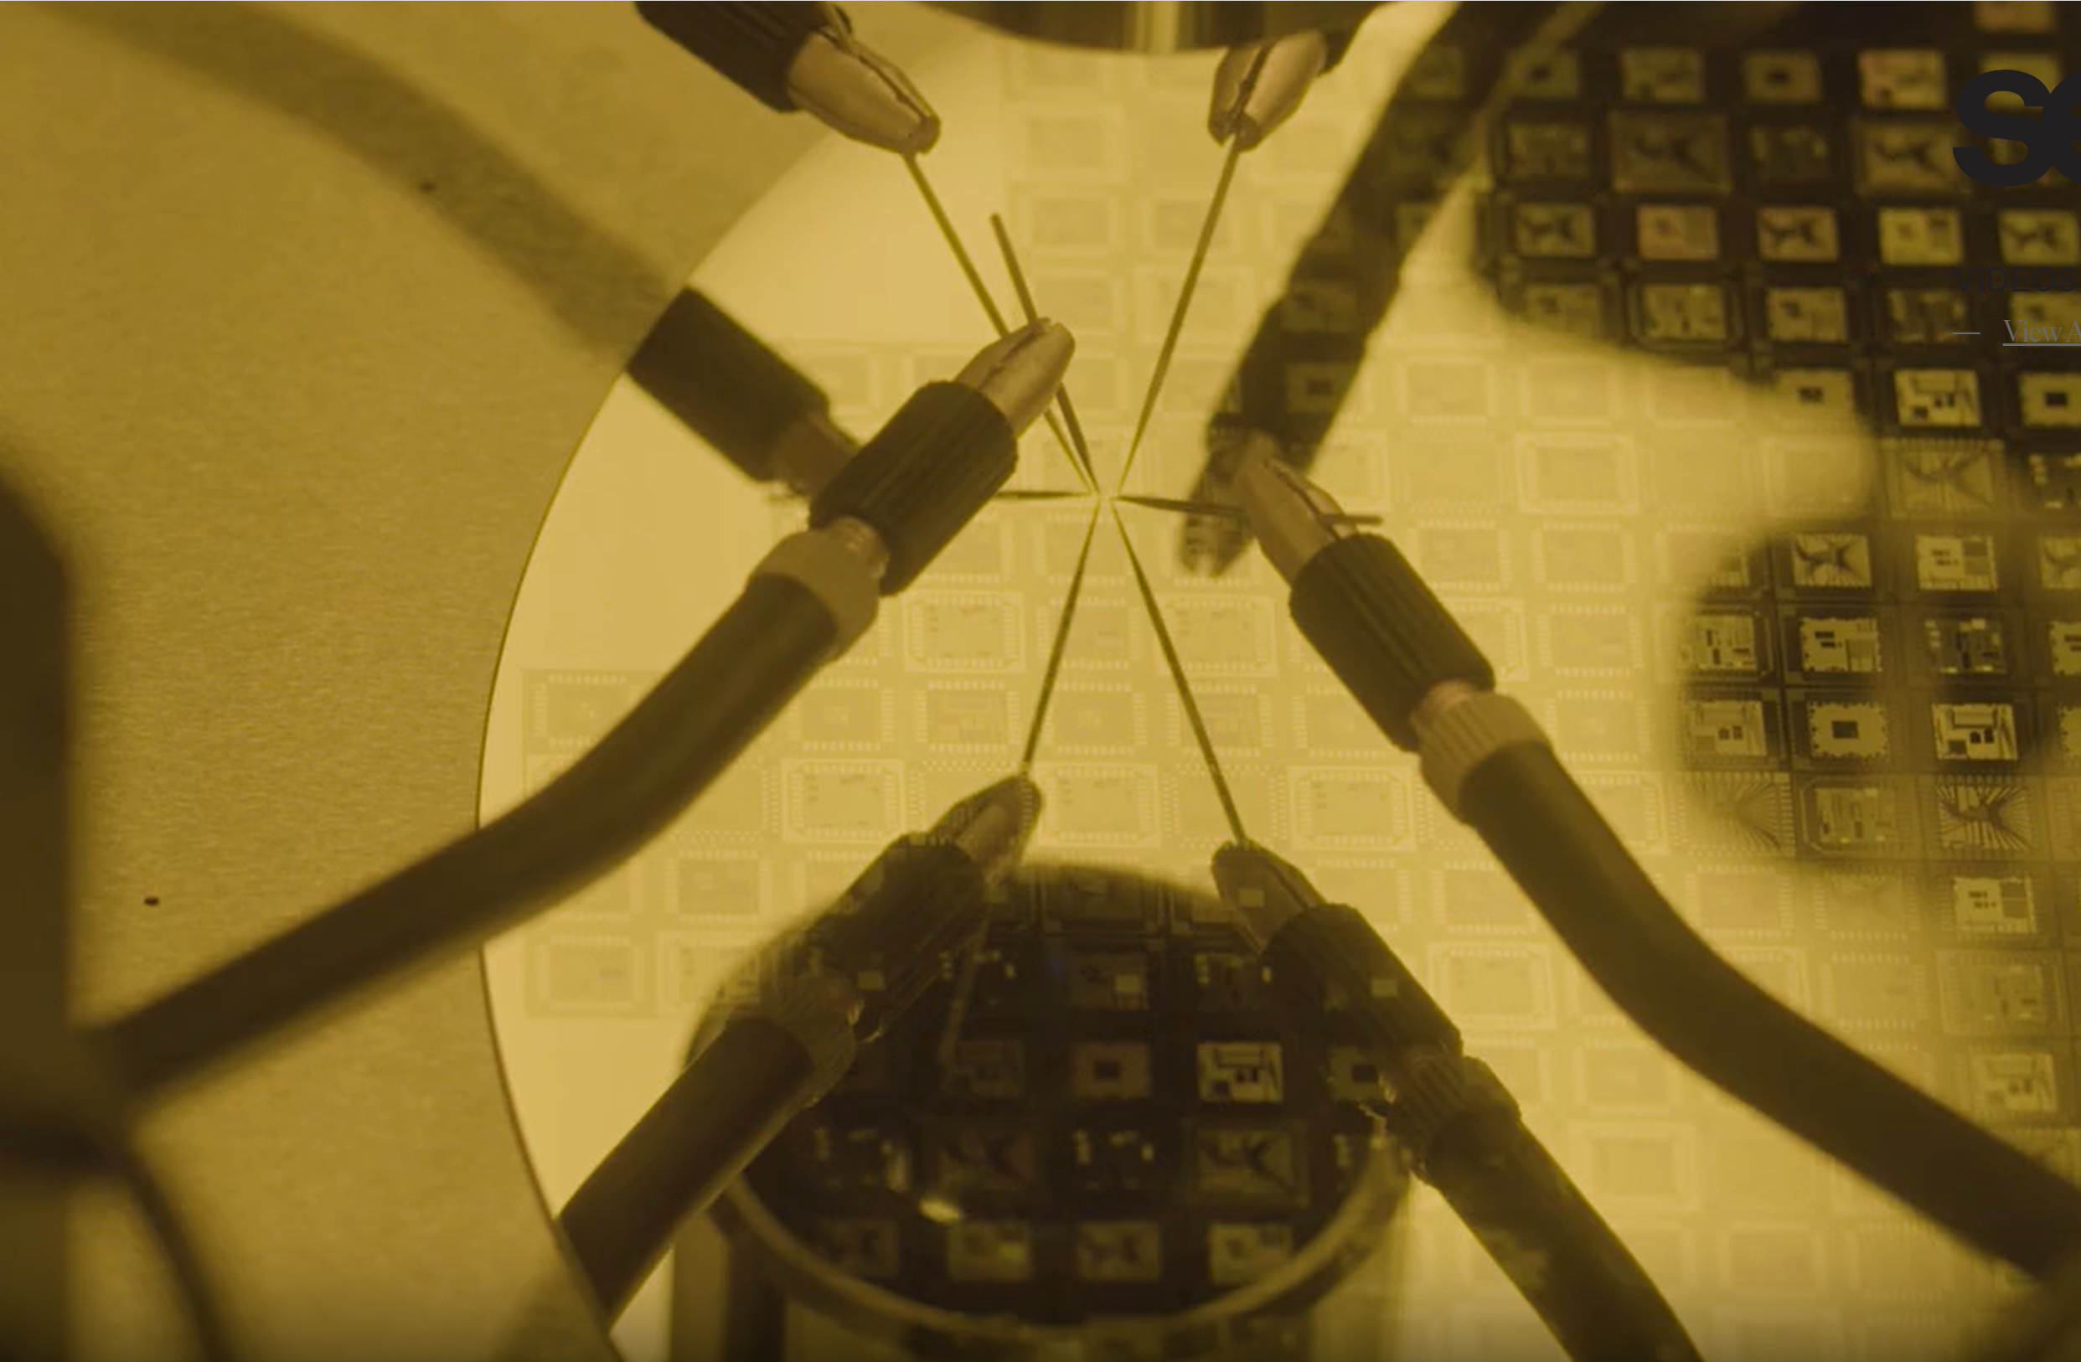
Bump bonding
Notes:
The carrier chip is made out of si coated with Al.
Every place where there should be a bumb, there is coated a layer of NbN first. The NbN separates the Al and the bumbs. The bumbs are made out of In. The NbN layer works as a diffusion layer, so Al will not make an intermetallic layer with In - ???
Further it protects the Al from corrosion when the bump is fabricated.
So under the bumb there is a metalization layer made out of NbN

Slide 8
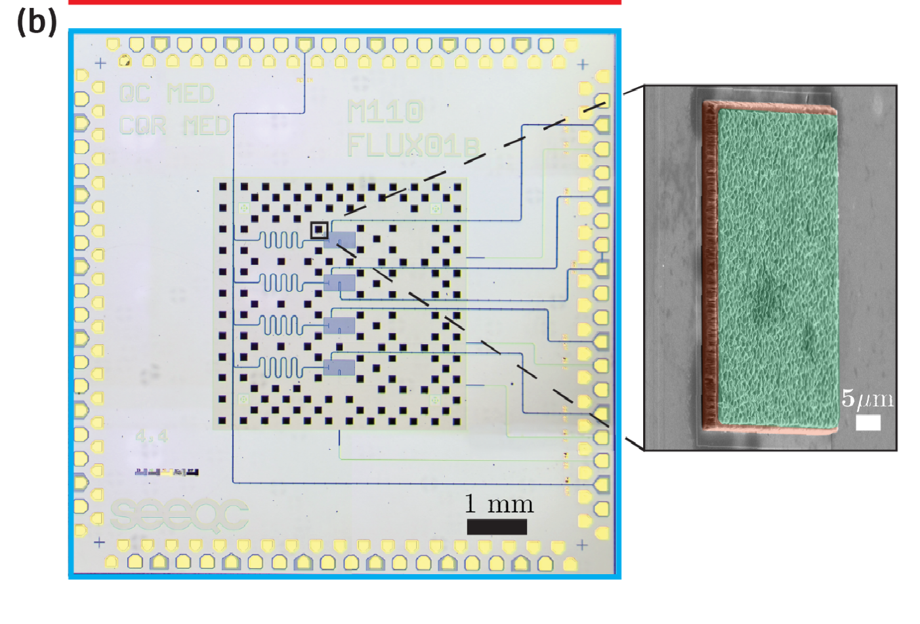
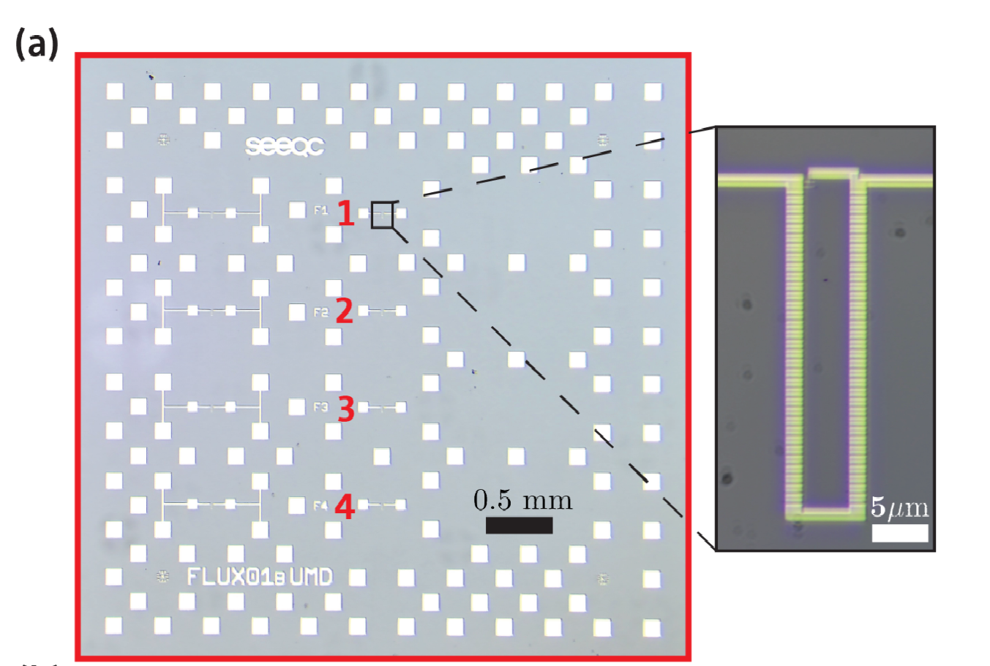
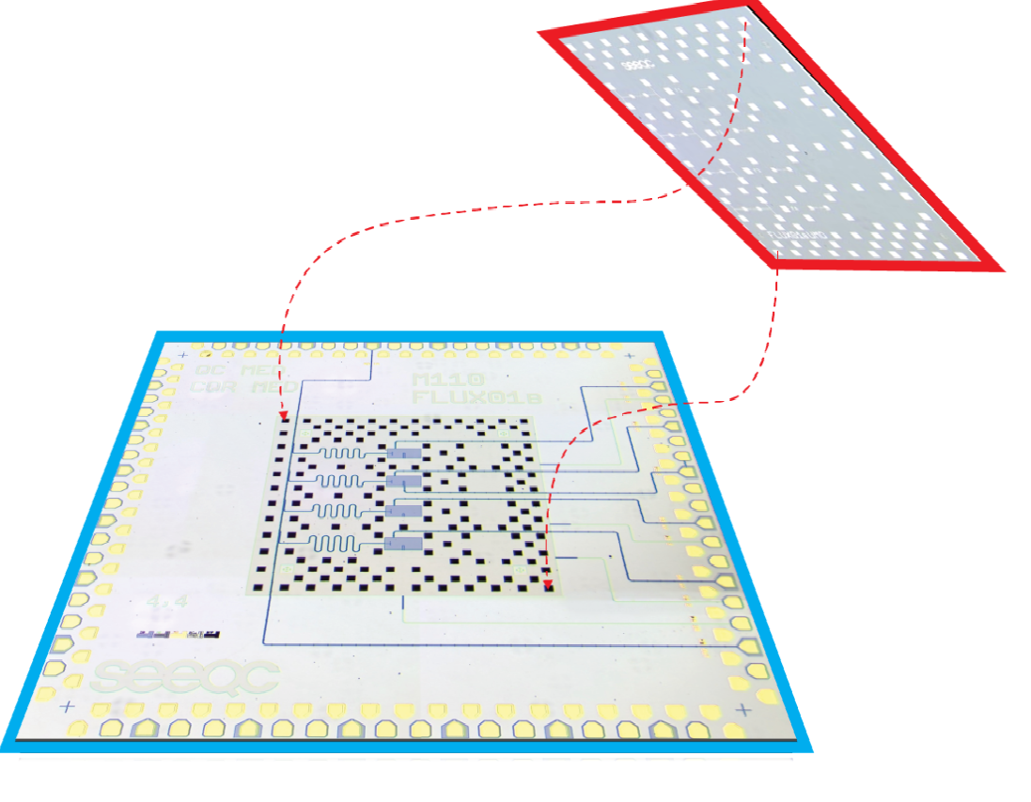
The setup
4 non-coupled fluxonium qubits on 1 QPU (flip chip)
Plassys made QPU!
The C-chip
Fit into each other
Notes:
- Each fluxonium qubit contains 138 large area JJ in an array.
Since they are not coupled they just look at 1 qubit (number 3).
The QPU (or the qubit is also made with the Plassys deposition
- The qubit performance does not significally degrade (even though there might be introduced other dielectrics or more fabrication steps, it does not have a significally impact on T_1.

Slide 9
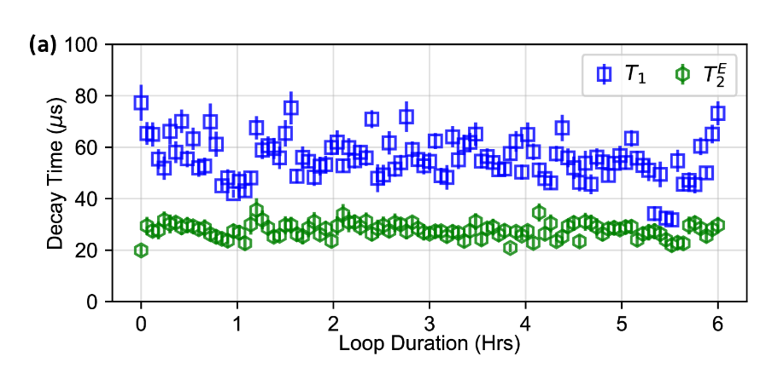
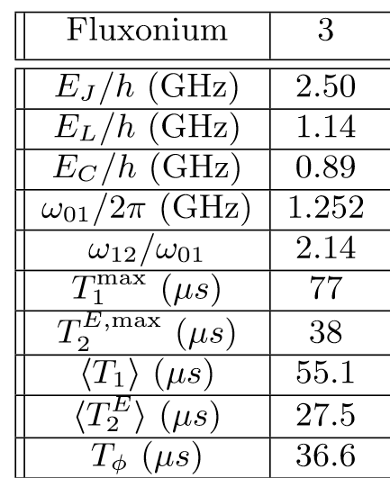
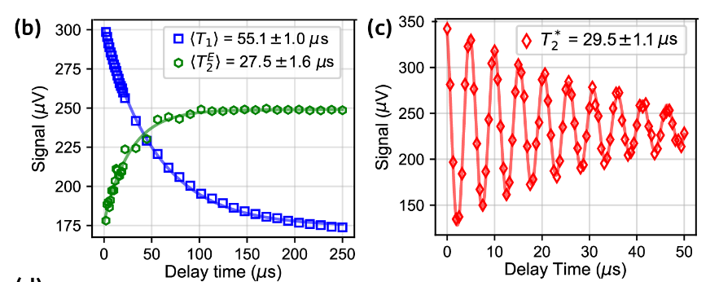
Their findings/measurements
Notes:
They had to verify if the new flip chip approach had an influence on the T_1 and T_2 times.
They focused on the third qubit
They measured the T_1 and T_2^E (prepared in a superposition – some rf pulses are applied ) measuring a type of decoherence by varying the time? (han echo time?) 101 measurements
The coherence times does not change even though we introduce more fabrication steps and other dielectrics which is really good. Then you don’t change scalability with anything.
Likely that their dephasing is caused by thermal photons of the resonator (resonator temperature of 70mK).
They measured all the decoherences times (EXPLAIN) and compare it to the newest fabricated fluxonium chip.
T_1 is limited by dielectric loss.
Then they did some benchmarking tests?

Slide 10
Comparison with previous work
Old parameters
EJ /h = 5 GHz
EL/h = 1.14 GHz
EC /h = 0.84 GHz
T1 = 250 us
T*2 = 150 us
Readout = 97% fidelity
Randomized benchmarking =99.991(1) %
Transition taken at Φe/Φ0 = 0.5.
New parameters
EJ /h = 2.5 GHz
EL/h = 1.14 GHz
EC /h = 0.89 GHz
T1 = 55.1 us !
T*2 = 29.5 ± 1.1 μs!
Readout = 97% fidelity
Randomized benchmarking =99.95 %
Transition taken at Φe/Φ0 = 0.5.

Slide 11
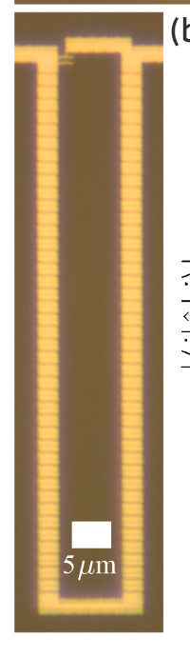
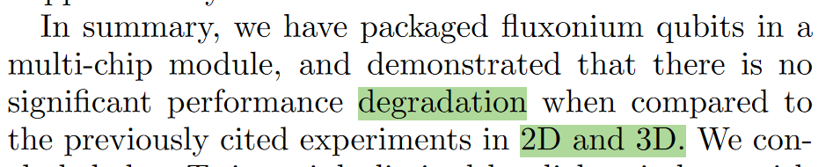
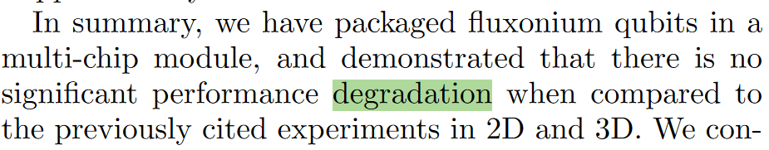
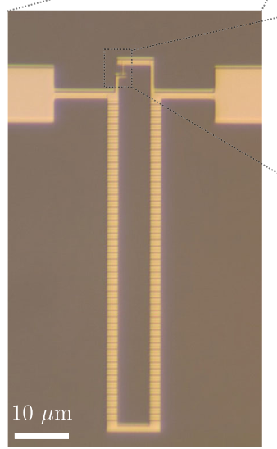
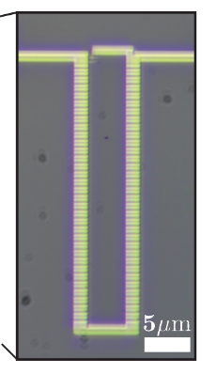
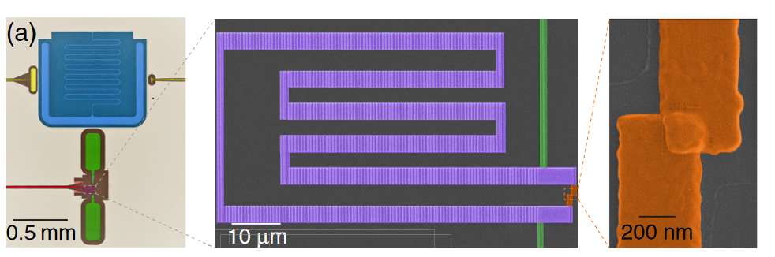
Nguyen2019 - High-Coherence Fluxonium Qubit,
Zhang2021 marts - Universal Fast-Flux Control of a Coherent, Low-Frequency Qubit
Notes:
They specifically do not mention 26 - A. Somoroff, Q. Millisecond Coherence in a Superconducting Qubit, arXiv:2103.08578 (2021) – marts. Their own previous work
They mention 25 - High-Coherence Fluxonium Qubit, Physical Review X 9, 041041 (2019) and
They mentiuon 34 (2D and 3D) - Universal Fast-Flux Control of a Coherent, Low-Frequency Qubit, Physical Review X 11, 011010 (2021). Zhang and shuster
That is not the worst part!!

Slide 12
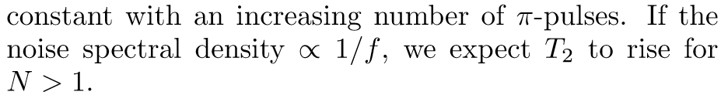
Comparison with their most recent work
Old parameters (2021)
EJ /h = 5.57 GHz
EL/h = 0.64 GHz
EC /h = 1.08 GHz
T1 = 1.20 ± 0.03 ms.
T*2 = 1.16 ± 0.05 ms
Randomized benchmarking =99.991(1) %
Transition taken at Φe/Φ0 = 0.5.
“Practically Unaffected by 1/f fluc noise”
New parameters (2023)
EJ /h = 2.5 GHz
EL/h = 1.14 GHz
EC /h = 0.89 GHz
T1 = 55.1 us = 0.0551 ms!
T*2 = 29.5 ± 1.1 μs = 0.0295 ms!
Readout = 97% fidelity
Randomized benchmarking =99.95 %
Transition taken at Φe/Φ0 = 0.5.
Maximum 77.3 ± 7.0 μs...
Maximum T*2 = 29.5±1.1
Notes:
It is the same group which proposed the fluxonium qubit
Each fluxonium qubit contains 138 large area JJ in an array.
Since they are not coupled they just look at 1 qubit (number 3).
The qubit performance does not significally degrade (even though there might be introduced other dielectrics or more fabrication steps, it does not have a significally impact on T_1.
- The benchmarking is 0.041 % worse.

Slide 13
Summery
The flip chip approach is good at scaling
It has shown to not degrade transmon qubits and flux qubits
(Maybe) it can be implementet in such a way, that it does not degrade the performance of fluxonium qubits.
Notes:
They were at the march meeting
But else, they are only on arxiv.

